Slide 1
Finding the best location for an Italian Restaurant in Amsterdam
Wineke van Lent
March 8, 2021

Slide 2
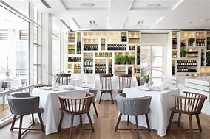
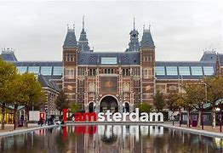
Background
International franchise company of high quality Italian restaurants wants advice on a location in Amsterdam
Amsterdam is the capital of the Netherlands with a population of 1,558,755 in the urban area
Amsterdam has a very small market for properties, sales go fast.
The real estate agents found 10 suitable locations for the new restaurant.

Slide 3
Research questions
The locations are more or less comparable
The neighbourhood is very important
Research questions
How comparable are the neighbourhoods of the possible locations?
How many competing Italian restaurant are available in these neighbourhoods?

Slide 4
Methodology
Analyzing the comparability of neighbourhoods in Amsterdam
Define the neighbourhoods. Provided by the city of Amsterdam: 'https://allecijfers.nl/gemeente-overzicht/amsterdam/'.
Use webscraping to collect the data and clean the data
Add the latitude and longitude of each location by using Geolocator
Data on the venues was collected with an API from Foursquare.
Combing the data on the neighbourhoods and the venues
K means clustering is used to measure the comparability of the neighbourhoods.
The final result of the neighbourhoods will be plotted on a map of Amsterdam.
Analyzing competing Italian restaurants in Amsterdam
Construct an API to collect data from Foursquare on Italian restaurants in Amsterdam.
Visualize the competing Italian restaurants on a map of Amsterdam.
Combine this map with the list of possible locations for the new restaurant

Slide 5
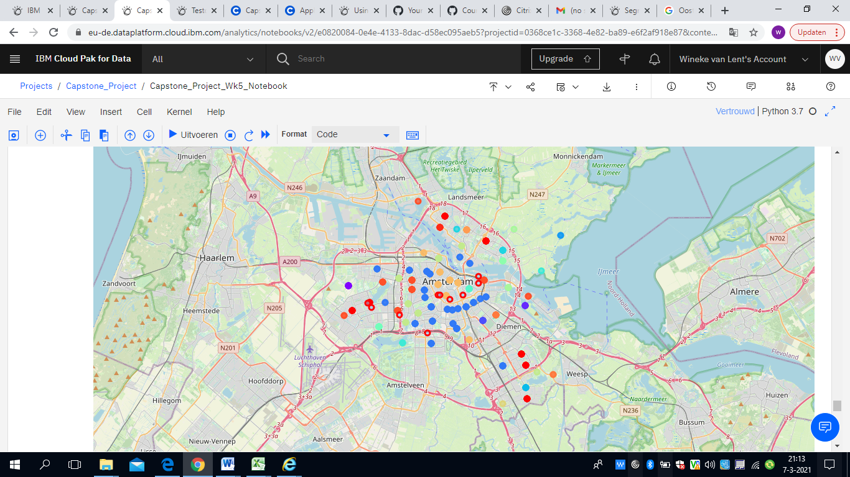
Results clustering neighbourhoods
Not suitable:
Nightlife/coffee shops
Shopping malls
20 clusters: multiple colors
Possible locations: red unfilled dots

Slide 6
Neighbourhoods summarized
Adress | Postal Code | Cluster | Cluster classification | Cluster description | Suitable
Leidseplein 9 | 1017 PS | 15 | Amsterdam Central | Nightlife | -
Leidsekruisstraat 11 | 1017 RE | 15 | Amsterdam Central | Nightlife | -
Reguliersgracht 110 | 1017 LX | 15 | Amsterdam Central | Nightlife | -
Meer en Vaart 405 | 1068 LH | 0 | Shopping cluster | Shopping | -
Osdorpplein 1014 | 1068 TG | 0 | Shopping cluster | Shopping | -
Oostelijke Handelskade 4 | 1019 HM | 18 | Restaurant cluster | Restaurants | +
Jacob Bontiusplaats 10 | 1018 LL | 18 | Restaurant cluster | Restaurants | +
Delflandplein 22 | 1062 HR | 18 | Restaurant cluster | Restaurants | +
Roetersstraat 15 | 1018 WD | 9 | Zoo cluster | Zoo, restaurants | +
Arnold Schönberglaan 9 | 1082 MJ | 4 | Park cluster | Park, bars, restaurants | +

Slide 7
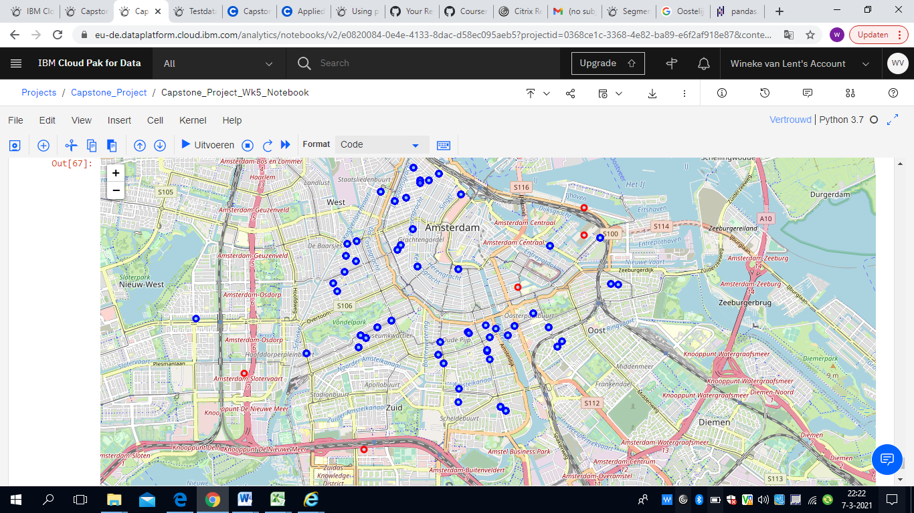
Results on competing Italian Restaurants
More competition in the right upper corner
Blue = competing Italian restaurants
Red = possible locations

Slide 8
Discussion; 2 possible locations are recommend
Adress | Postal Code | Cluster | Cluster classification | Cluster description | Suitable neighbourhood | Suitable for competing ?
Leidseplein 9 | 1017 PS | 15 | Amsterdam Central | Nightlife | - | Not relevant
Leidsekruisstraat 11 | 1017 RE | 15 | Amsterdam Central | Nightlife | - | Not relevant
Reguliersgracht 110 | 1017 LX | 15 | Amsterdam Central | Nightlife | - | Not relevant
Meer en Vaart 405 | 1068 LH | 0 | Shopping cluster | Shopping | - | Not relevant
Osdorpplein 1014 | 1068 TG | 0 | Shopping cluster | Shopping | - | Not relevant
Oostelijke Handelskade 4 | 1019 HM | 18 | Restaurant cluster | Restaurants | + | 0
Jacob Bontiusplaats 10 | 1018 LL | 18 | Restaurant cluster | Restaurants | + | 0
Delflandplein 22 | 1062 HR | 18 | Restaurant cluster | Restaurants | + | 0
Roetersstraat 15 | 1018 WD | 9 | Zoo cluster | Zoo, restaurants | + | +
Arnold Schönberglaan 9 | 1082 MJ | 4 | Park cluster | Park, bars, restaurants | + | +

Slide 9
Conclusion
Based on the neighbourhood and the competing Italian Restaurants we recommend the following locations:
Roeterstraat 15
Arnold Schönberglaan 9

